Slide 1





Making My Data FAIR as a Data Steward
What could go wrong?
Nami Sunami
Data Steward | TU Eindhoven
n.sunami@tue.nl
DOI: 10.53962/sacf-0q0q
This work is marked with CC0
v2025.11.18

Slide 2
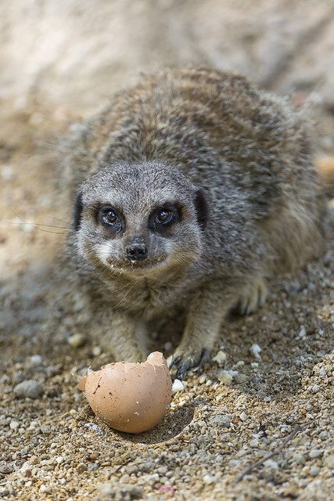
12:30-12:40 Let’s have lunch
https://www.flickr.com/photos/tambako/9519162601/
Notes:
https://www.researchequals.com/modules/x4b0-jtqj

Slide 3

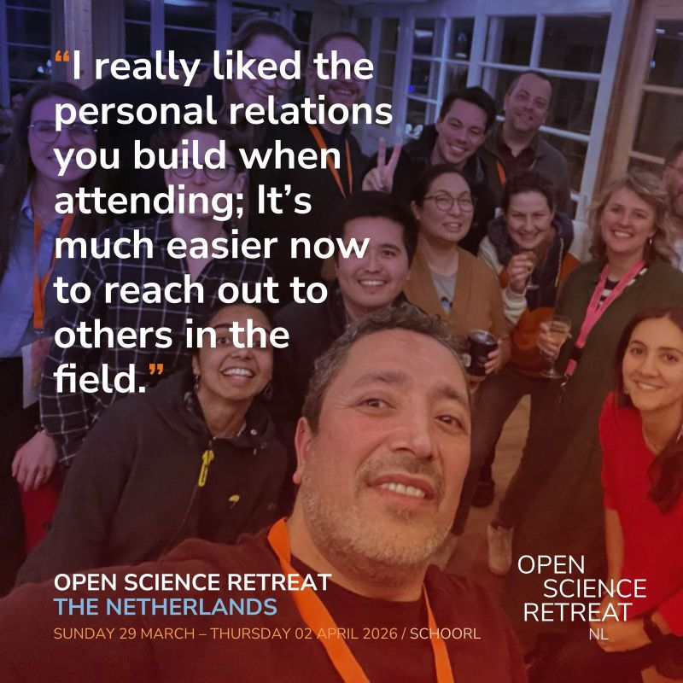

Join Open Science Retreat
Dutch Edition 29 March —2 April 2026
Global Edition (UK) 7–11 April 2026
Presentation will start at 12:40

Slide 4
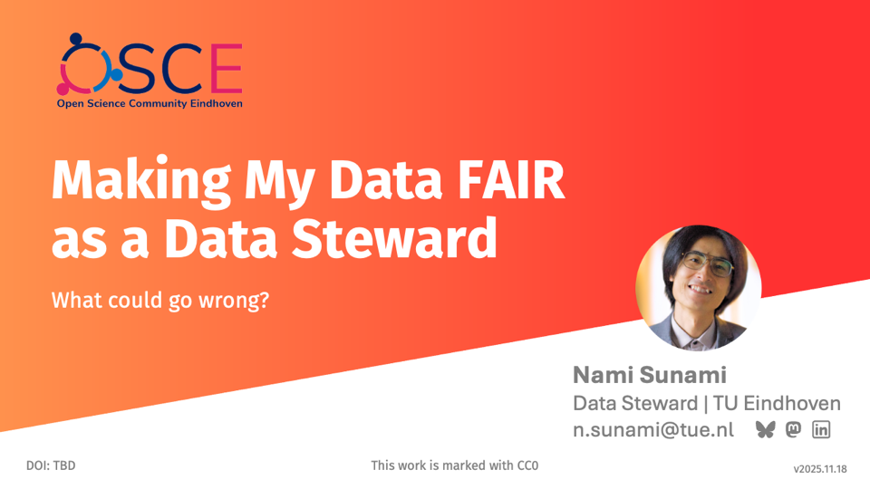


Slide 6
I made a docker container for my thesis
Previously

Slide 7
I shared regrets

Slide 8
Reminder
I am a Data Steward

Slide 9
Data Steward advises researchers to make their data FAIR

Slide 12
I am a Data Steward
My data is not FAIR

Slide 13
I want to fix this!

Slide 14
First, let’s define terms

Slide 15
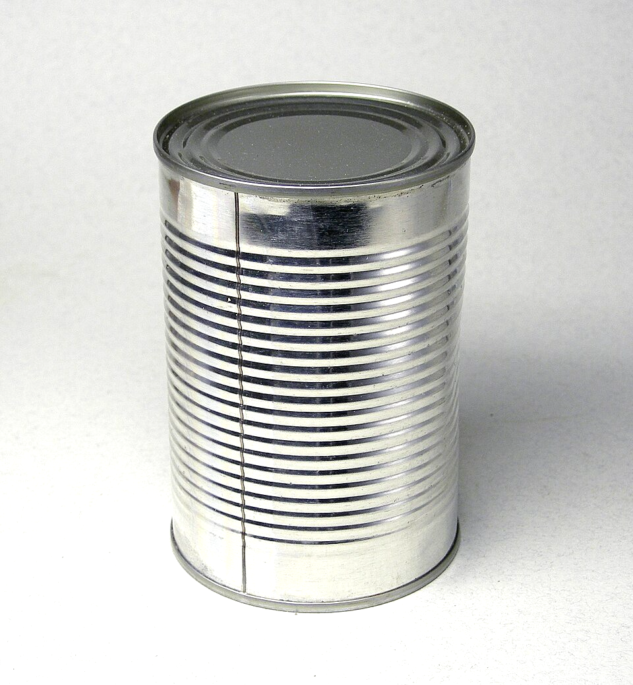
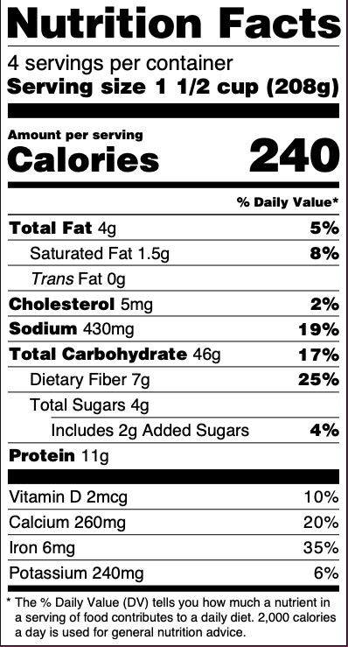
"Research Data"
Data itself
Metadata
Konservendose by Rainer Zenz, CC BY-SA 3.0, via Wikimedia Commons

Slide 16
What are FAIR data principles?

Slide 17




Findable
Accessible
Interoperable
Reusable
Open Data
FAIR Data
https://www.go-fair.org/fair-principles/
Notes:
Findable and accessible can be covered by being open, but not other two

Slide 18

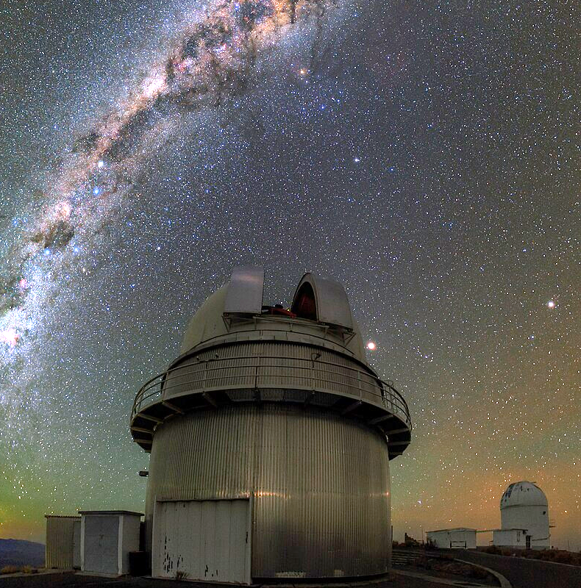
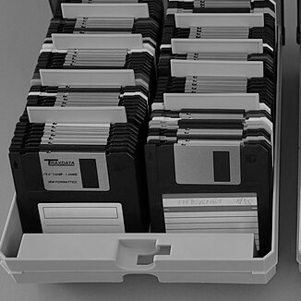
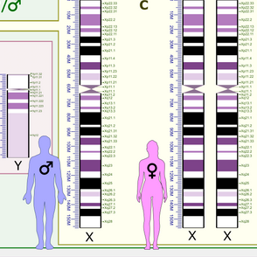
FAIR & Open
Open
Closed
Not FAIR
FAIR
Notes:
Kaggle: from the website
Telescope: By ESO/B. Tafreshi (twanight.org) - http://www.eso.org/public/images/potw1512a/, CC BY 4.0, https://commons.wikimedia.org/w/index.php?curid=39502519
ESO data can be found on https://archive.eso.org/cms.html
Floppy disks: https://commons.wikimedia.org/wiki/File:MF-2HD_Disketten_3%C2%BD-inch_floppy_disks_3%C2%BD-inch_floppy_disk_storage.JPG
Genes: https://en.wikipedia.org/wiki/File:Human_karyotype_with_bands_and_sub-bands.png

Slide 19
Previous state of my data

Slide 20
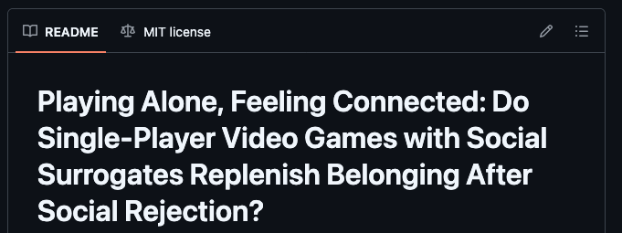
I had all my code and data in one Git repository

Slide 21
A journey of a thousand miles begins with a single step.

Slide 22
A journey to FAIR data begins with ______________________________.

Slide 23
A journey to FAIR data begins with posting data on a data repository.

Slide 24
First goal: Post my data on Zenodo

Slide 26
What were my challenges?
A
Having multiple datasets
B
Not knowing metadata schema
C
Variables lacked documentation
E
All of the above

Slide 27
What were my challenges?
A
Having multiple datasets
B
Not knowing metadata schema
C
Variables lacked documentation
E
All of the above

Slide 28
Challenge 1
Study 1
8 datasets
Having multiple datasets
Study 2
1 dataset
Study 3
1 dataset

Slide 29
Which dataset did I choose?
A. Study 1 datasets
B. Study 2 dataset
C. Study 3 dataset
D. Chose all datasets

Slide 30
I chose Study 2
Study 1
8 datasets
Because I thought it was the simplest
Study 2
1 dataset
Study 3
1 dataset

Slide 31
Challenge 2
Not knowing metadata standard

Slide 32
Searching for metadata schema on resources
FAIRsharing Standards Search
DCC Metadata Standards List
RDA Metadata Standards Catalog

Slide 33
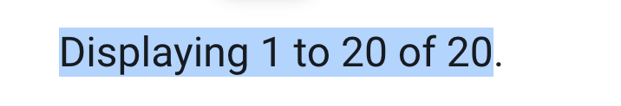
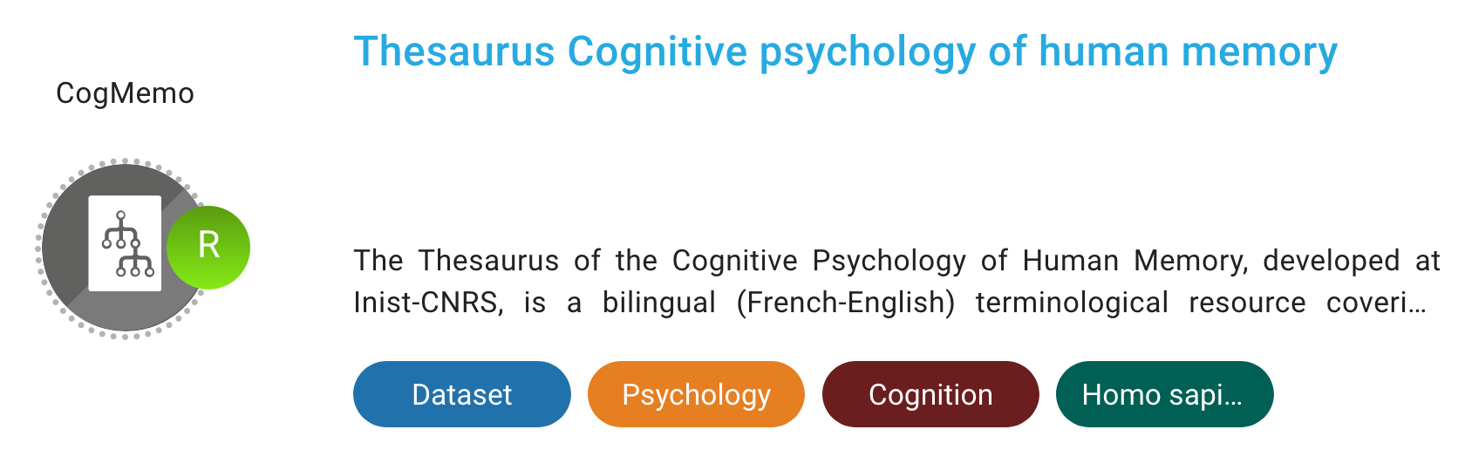
I was lost in search
Many standards
Too specific for my project

Slide 34

Most standards were too generic or too specific
Usefulness for me
CogMemo Thesaurus
Specificity

Slide 35
What did I do next?
A. I chose a generic standard
B. I chose a specific standard
C. I searched more standards
D. I searched for happy memories

Slide 36
What did I do next?
A. I chose a generic standard
B. I chose a specific standard
C. I searched more standards
D. I searched for happy memories

Slide 37
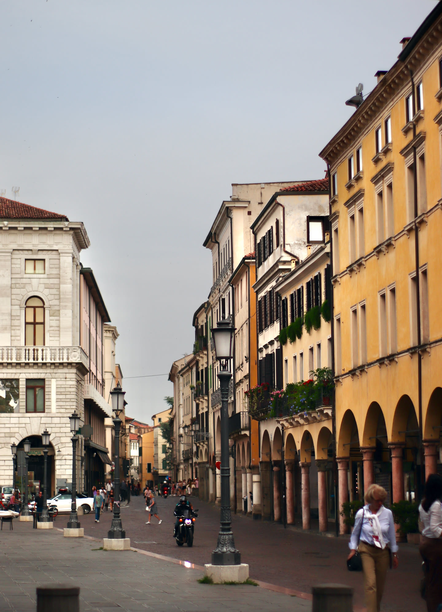
I remembered my time in Italy
Society of Improvement of Psychological Science (SIPS) 2023 Conference

Slide 38
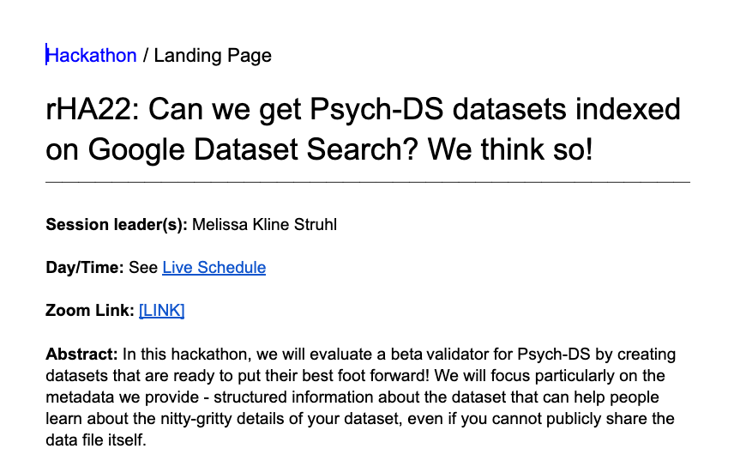
I attended a hackathon for Psych-DS
https://docs.google.com/document/d/1Vf0yIq9KwQhFWp2jKc9jBRjhu5Gds2HUqmw5rqUGzD8/edit?tab=t.0
Notes:
SIPS 2023 Schedule: https://docs.google.com/spreadsheets/d/1eeyRx6oxVDWwgUYGTZKIuWVNJfqqjx3O6RTN08SulvU/edit?gid=1435057465#gid=1435057465

Slide 39
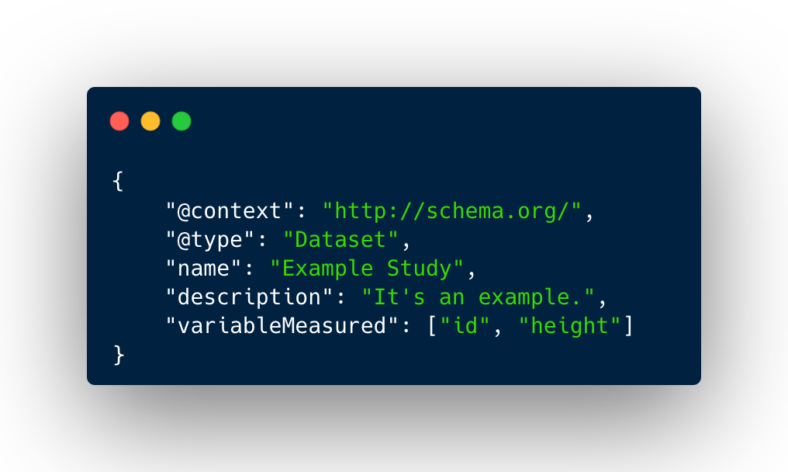
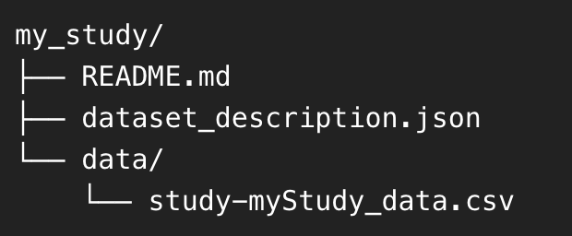
Psych-DS is a community data standard
Project structure
Simple metadata
https://psych-ds.github.io/

Slide 40
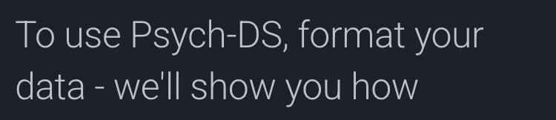
Psych-DS provides a step-by-step guide
https://psychds-docs.readthedocs.io/en/latest/guides/1_getting_started/

Slide 41
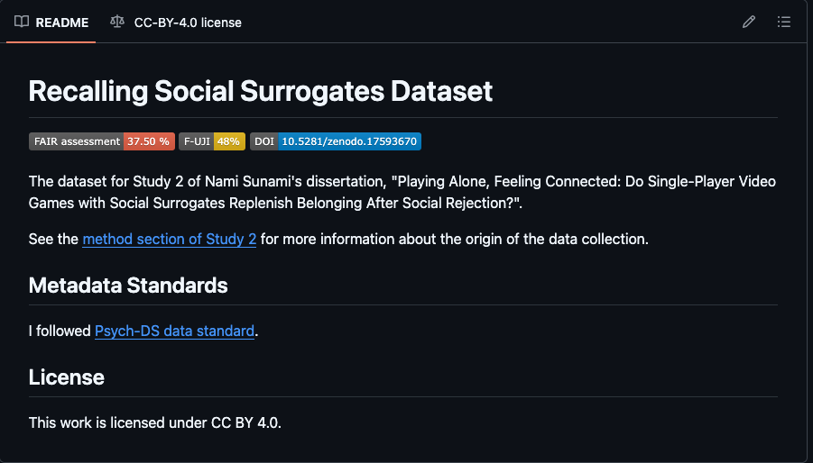
I made a Git repository with Psych-DS metadata

Slide 42
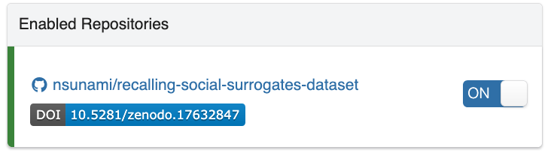
I published the repository on Zenodo

Slide 43
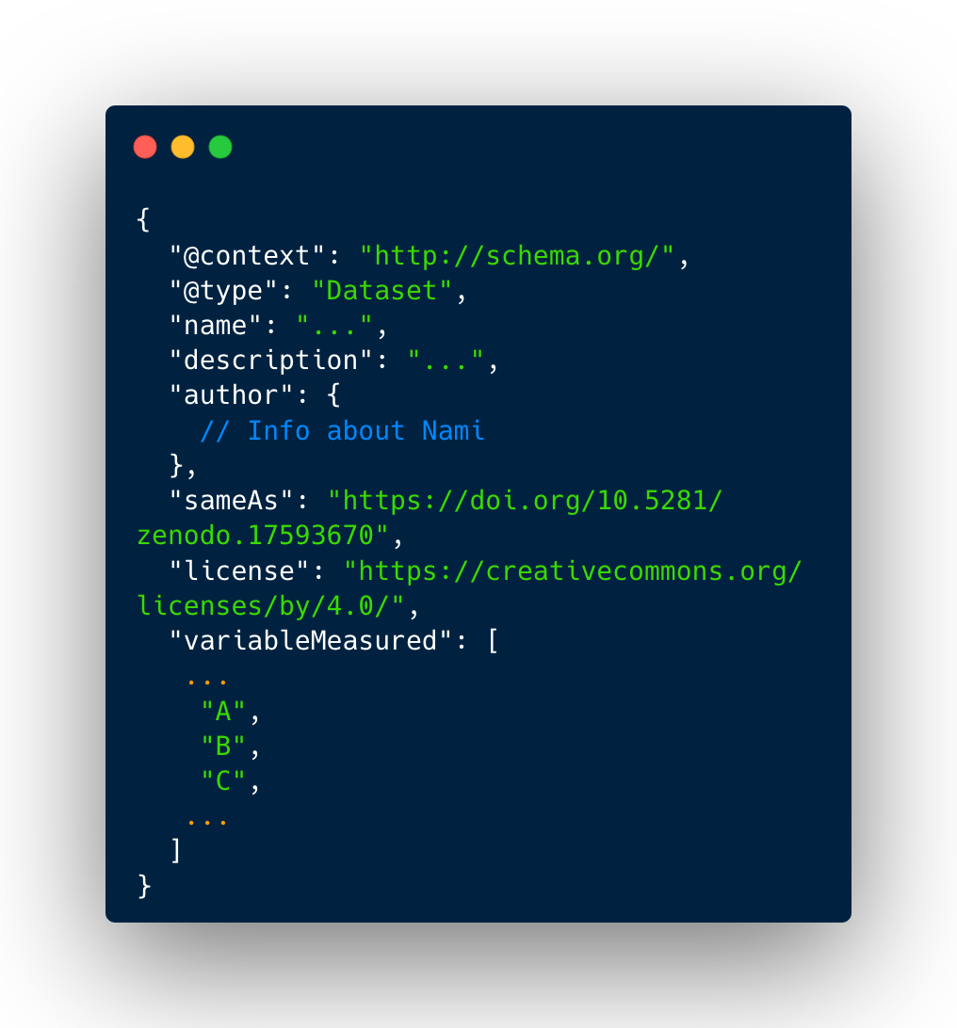
The metadata about the dataset was looking ok

Slide 44
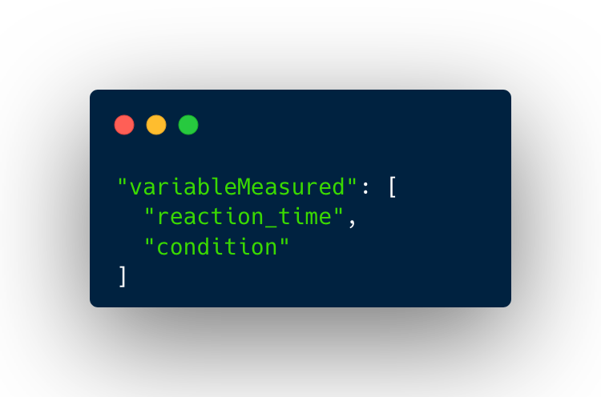
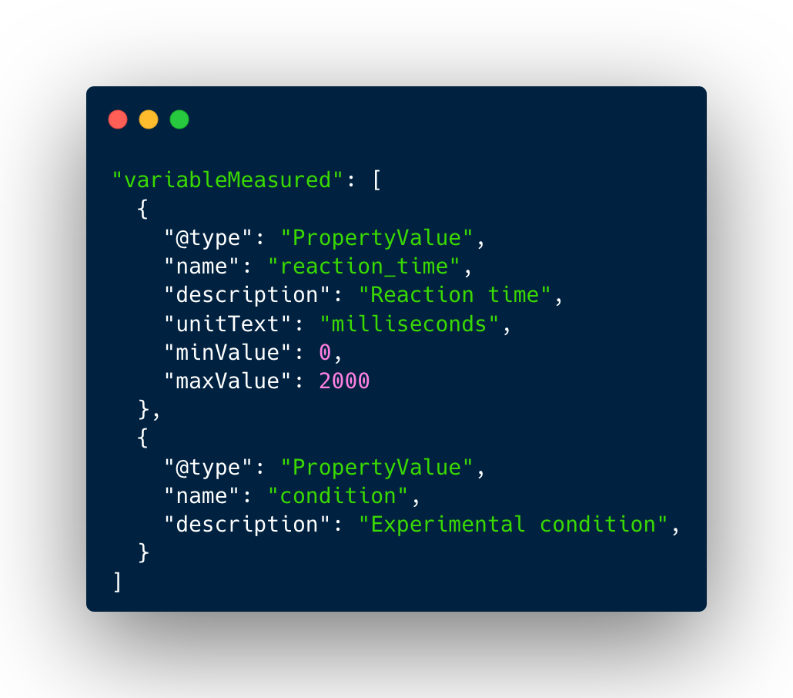
But how about metadata about variables

Slide 45
So, I looked into my variable-level metadata

Slide 46
Challenge 3
WTF are these variables?
My variables lacked documentation
A | B | C
Yes | Yes | Yes
Yes | Yes | No
Yes | Yes | Yes

Slide 47
Luckily, I embedded variable description in my original dataset

Slide 48


I wrote a script to export the variable labels into Psych-DS metadata
Updated metadata
Script to export variable labels
My data

Slide 49
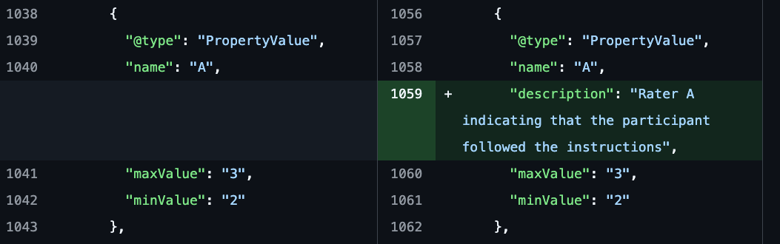
I also manually updated variable metadata

Slide 50
It was a lot of work

Slide 51
Why am I doing this?
Do any of these matter?

Slide 52
Watch out for FAIR Data Burnout!

Slide 54
There are tools to score FAIR-ness of a dataset.
FAIR-Checker
F-UJI

Slide 55
Zenodo entry has higher scores
Checker used | GitHub | Zenodo
FAIR-Checker | 37.50% | 91.67%
F-UJI | 42% | 84%
Are the scores useful?

Slide 56

Title
Useful for institutions and evaluators
Generic metadata
Author
License
Materials
Specific metadata
Useful for researchers in the field
Instrument
Parameters
Photo by SIMON LEE on Unsplash

Slide 58
Why are we making data FAIR?

Slide 59
We make data FAIR, so that someone else can re-use the data.

Slide 60
Who is the that someone else?

Slide 61
A future data user can be me.

Slide 62
If I were to do it again, I’d try to make a link with another dataset.
So that I can produce new piece of information, for myself to enjoy

Slide 63
What are your questions?
Notes:
Open the chat

Slide 64
What are your challenges?
Questions
What are your experiences making your data FAIR?
Notes:
Open the chat

Slide 65



Join Our Community
openscience@tue.nl
sites.google.com/view/osceindhoven
Notes:
If you would like to join a community of like-minded people at TU/e – you are welcome to become a member of the OS community Eindhoven.
It’s a space where you can exchange experiences with fellow researchers, learn something new and/or share your knowledge with others.
Starting from the new academic year, we are going to have budget from NWO which will help the community to develop and grow and you can be part of it.

Slide 66
Links
GitHub | dataset
GitHub | Nami’s dissertation

